Slide 1
Engineering Graphics Lecture Notes
SUMMARY OF PROJECTION OF LINES
S.NO | POSITION OF LINE | FRONT VIEW | TOP VIEW
1 | LINE PARALLEL TO BOTH V.P & H.P | HORIZONTAL LINE PARALLEL TO XY | HORIZONTAL LINE PARALLEL TO XY
2 | LINE PERPENDICULAR TO H.P AND PARALLEL TO V.P | VERTICAL LINE | POINT
3 | LINE PERPENDICULAR TO V.P AND PARALLEL TO H.P | POINT | VERTICAL LINE
4 | LINE PARALLEL TO H.P AND INCLINED TO V.P AT ANGLE “Ѳ” | LINE PARALLEL TO XY WITH FORESHORTENED LENGTH | INCLINED LINE WITH TRUE LENGTH
5 | LINE PARALLEL TO V.P AND INCLINED TO H.P AT ANGLE“Ѳ” | INCLINED LINE WITH TRUE LENGTH | LINE PARALLEL TO XY WITH FORESHORTENED LENGTH

Slide 2
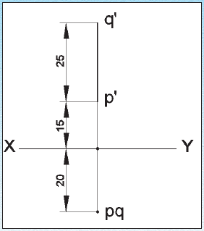
Engineering Graphics Lecture Notes
EXAMPLE PROBLEMS:-
I.DRAW THE PROJECTION OF A LINE PQ, 25 mm LONG IN THE FOLLOWING POSITIONS
Perpendicular to the H.P., 20 mm infront of V.P and its one end 15 mm above the H.P

Slide 3
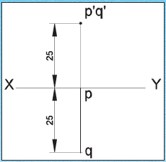
Engineering Graphics Lecture Notes
EXAMPLE PROBLEMS:-
ii.DRAW THE PROJECTION OF A LINE PQ, 25 mm LONG IN THE FOLLOWING POSITIONS
Perpendicular to the V.P., 25 mm above the H.P and its end in the V.P

Slide 4
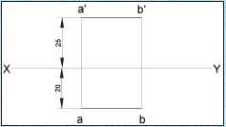
Engineering Graphics Lecture Notes
EXAMPLE PROBLEMS:-
iii.Draw the projection of a 30 mm long AB, straight line parallel to both H.P and V.P and 25 mm above H.P and 20 mm infront of V.P

Slide 5
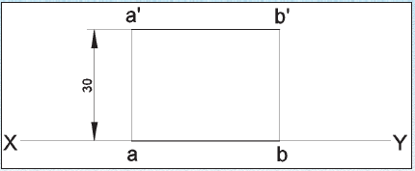
Engineering Graphics Lecture Notes
EXAMPLE PROBLEMS:-
IV.Draw the projection of a 30 mm long AB, straight line parallel to and 30 mm above H.P and in the V.P

Slide 6
PROJECTION RULE OF PARALLELISM
If a straight line is parallel to a principal plane, its projection on the same principal plane must be equal to its True Length (T.L.), whereas its projection on the other principal plane must be parallel to the xy line.
Line is parallel to the H.P., therefore its T.V. is T.L. and F.V. parallel to xy.
Line is parallel to the V.P., therefore its F.V. is T.L. and T.V. parallel to xy.

Slide 7
Line is parallel to the H.P., therefore its T.V. is T.L. and F.V. parallel to xy.

Slide 8
Line is parallel to the H.P., therefore its T.V. is T.L. and F.V. parallel to xy.

Slide 9
Line is parallel to the V.P., therefore its F.V. is T.L. and T.V. parallel to xy.

Slide 10
Line is parallel to the V.P., therefore its F.V. is T.L. and T.V. parallel to xy.

Slide 11
If the F.V. is T.L., then the T.V. is parallel to xy line.
If the T.V. is T.L., then the F.V. is parallel to xy line.
If the T.V. is parallel to xy line, then the F.V. is T.L.
If the F.V. is parallel to xy line, then the T.V. is T.L.
If one view is T.L., the other must be parallel to xy.
If one view is parallel to xy, the other must be T.L.

Slide 12
Straight line AB
End A is 40 mm above the H.P. and 50 mm in front of the V.P.
Line is parallel to the V.P. and inclined to the H.P., therefore F.V. (a’b’) is T.L.
End B is also above the H.P. and in front of the V.P.

Slide 13
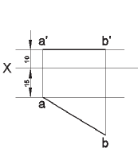
Engineering Graphics Lecture Notes
EXAMPLE PROBLEMS:-
V.Draw the projection of a straight line AB of 40 mm length is parallel to the H.P and inclined at 30° to the V.P. its end point A is 10 mm from the H.P and 15 mm from the V.P

Slide 14
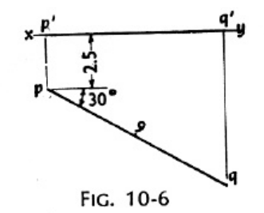
A line PQ, 9 cm long, is in the H.P. and makes an angle of 30 with the V.P. Its end P is 2.5 cm in front of the V.P. Draw its projections
As the line is in the H.P., its top view will show the true length
and the true inclination with the V.P. Its front view will be in xy.
i. Mark a point p, the top view 2.5 cm below xy. Draw a line pq
equal to 9 cm and inclined at 300
to xy.
ii. Project p to p’ and q to q’ on xy. pq and p’ q’ are the required
top view and front view respective

Slide 15
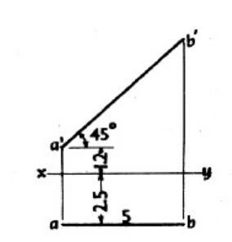
:The length of the top view of a line
parallel to the V.P. and inclined at 450
to the H.P. is 5 cm. One
end of the line is 1.2 cm above the H.P. and 2.5 cm in front of
the V.P. Draw the projections of the line and determines its true
length.
As the line is parallel to the V.P., its top view will be parallel to xy and the front view will shows its true length and the true
inclination with the H.P.
i. Mark a, the top view, 2.5 cm below xy and a’, the front view 1.2 cm above xy.
ii. Draw the top view ab 5 cm long and parallel to xy and draw Projector through b.
iii. From a’ draw a line making 45 angle with xy and cutting the projector through b at b’. Then a’ b’ is the front view and also the true length of the line.

